Slide 1
MOD-04 Sensor Modeling, Measurement & Fusion
MOBILE ROBOTS
By Dr. Ahmad Abbadi

Slide 2
The MediBot Challenge
Mission: Hospital delivery robot — Pharmacy → Ward B (Floor 3) → Lab
ZERO collisions — patients, nurses, wheelchairs, IV stands
Hospital environment challenges:
Polished floors → wheel slip
Glass doors
People walk unpredictably, carts appear suddenly
Elevators → vibration, tilt, no external references
Lighting: bright lobby ↔ dim corridors ↔ flickering fluorescents
Core question: Every sensor lies differently.
How do we model, quantify uncertainty, and combine sensors?
Approach: Add 6 sensors one at a time. Each failure → next sensor.

Slide 3

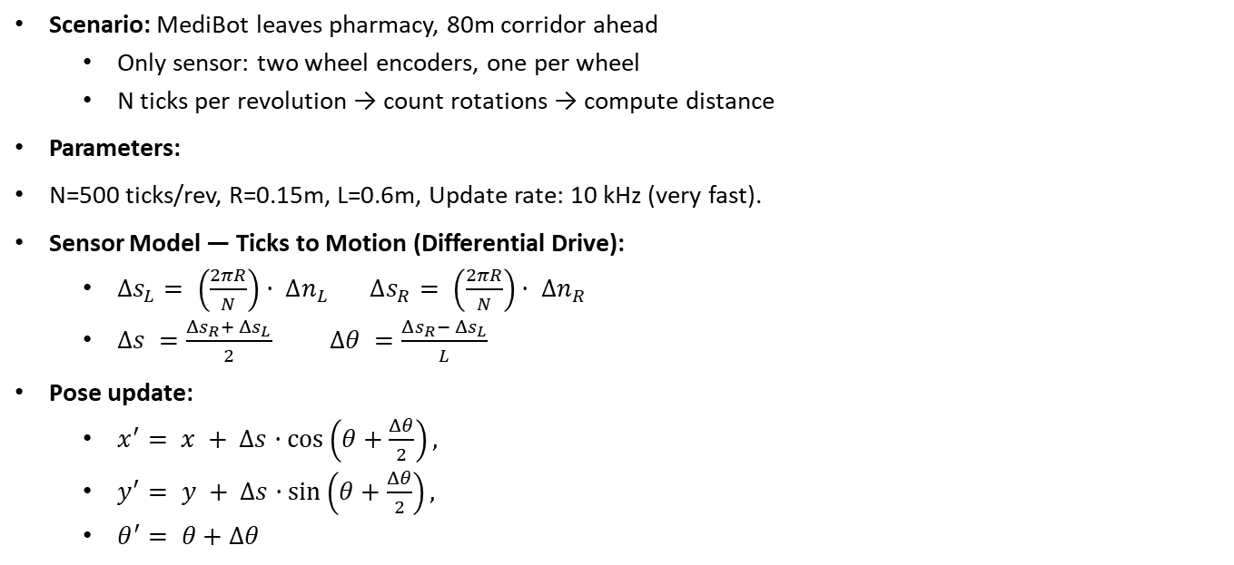
Block 1: Wheel Encoders — Scenario
Scenario: MediBot leaves pharmacy, 80m corridor ahead
Only sensor: two wheel encoders, one per wheel
N ticks per revolution → count rotations → compute distance
Parameters:
N=500 ticks/rev, R=0.15m, L=0.6m, Update rate: 10 kHz (very fast).
Sensor Model — Ticks to Motion (Differential Drive):
$Δs_{L}= \left(\frac{2πR}{N}\right)· Δn_{L} Δs_{R}= \left(\frac{2πR}{N}\right)· Δn_{R}$
$Δs =\frac{Δs_{R}+ Δs_{L}}{2} Δθ =\frac{Δs_{R}− Δs_{L}}{L}$
Pose update:
$x^{′}= x + Δs·\cos\left(θ+\frac{Δθ}{2}\right),$
$y^{′}= y + Δs·\sin\left(θ+\frac{Δθ}{2}\right),$
$θ^{′}= θ+Δθ$
$Δs_{L}$, $Δs_{R}$distance traveled by each wheel
$Δn_{L​},Δn_{R}$​ = number of ticks counted in one time step
R = wheel radius
N = ticks per revolution
L = wheelbase
We use θ+Δθ/2 (mid-point Euler integration angle) for better accuracy than using θ​ alone.
Block 1/8 — Proprioceptive sensor | Mid-point Euler integration

Slide 4
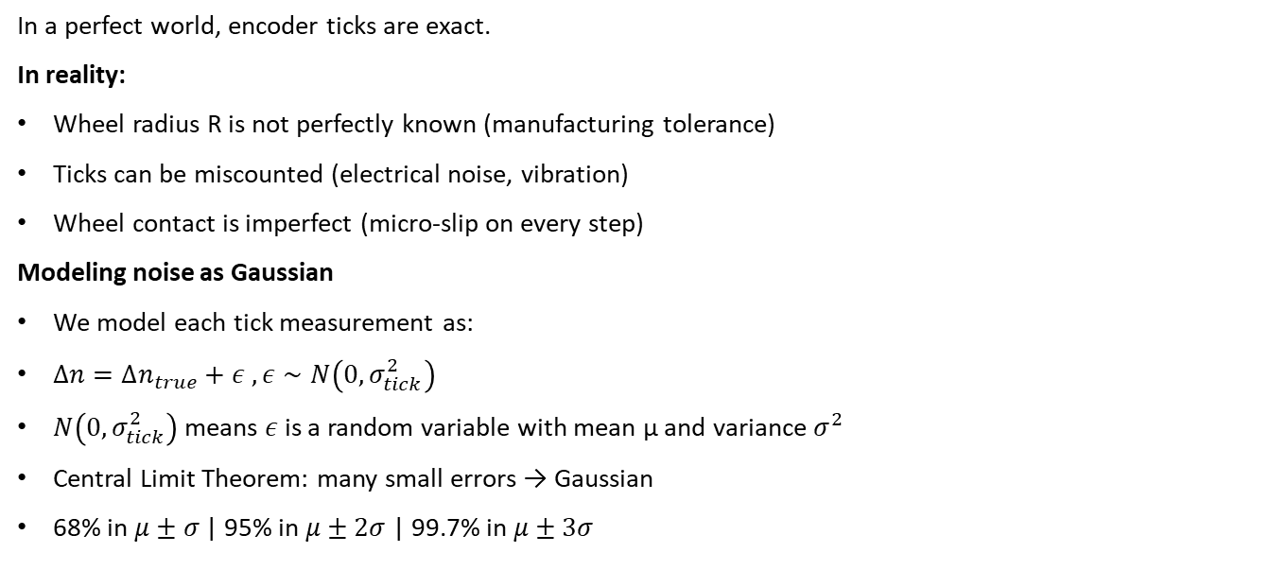
Block 1: Wheel Encoders — Noise
In a perfect world, encoder ticks are exact.
In reality:
Wheel radius R is not perfectly known (manufacturing tolerance)
Ticks can be miscounted (electrical noise, vibration)
Wheel contact is imperfect (micro-slip on every step)
Modeling noise as Gaussian
We model each tick measurement as:
$Δn=Δn_{true}+ε ,ε∼N\left(0,σ_{tick}^{2}\right)$
$N\left(0,σ_{tick}^{2}\right)$means $ε$ is a random variable with mean μ and variance $σ^{2}$
Central Limit Theorem: many small errors → Gaussian
68% in $μ±σ$ | 95% in $μ±2σ$| 99.7% in $μ±3σ$
Block 1/8 — Proprioceptive sensor | Mid-point Euler integration

Slide 5
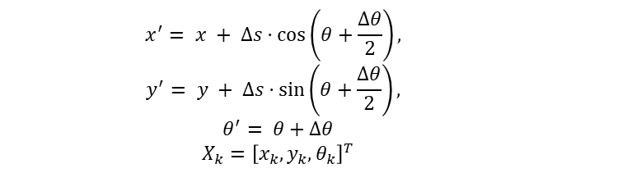
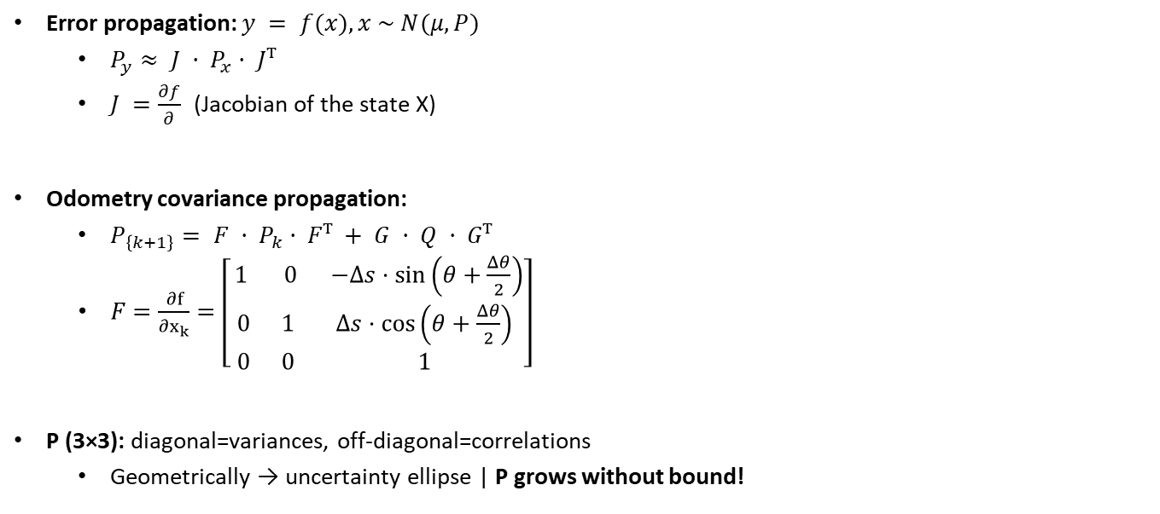
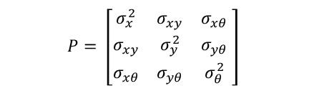
Gaussian Noise & Error Propagation
Error propagation: $y = f(x), x \sim N(μ, P)$
$P_{y}≈ J · P_{x}· Jᵀ$
$J =\frac{∂f}{∂}$ (Jacobian of the state X)
Odometry covariance propagation:
$P_{\left\{k+1\right\}}= F · P_{k}· Fᵀ + G · Q · Gᵀ$
$F=\frac{∂f}{∂x_{k}}=\left[\begin{matrix}1 & 0 & −Δs·\sin\left(θ+\frac{Δθ}{2}\right) \\ 0 & 1 & Δs·\cos\left(θ+\frac{Δθ}{2}\right) \\ 0 & 0 & 1\end{matrix}\right]$
P (3×3): diagonal=variances, off-diagonal=correlations
Geometrically → uncertainty ellipse | P grows without bound!
$$x^{′}= x + Δs·\cos\left(θ+\frac{Δθ}{2}\right),$$
$$y^{′}= y + Δs·\sin\left(θ+\frac{Δθ}{2}\right),$$
$$θ^{′}= θ+Δθ$$
$$X_{k​}={\left[x_{k​},y_{k​},θ_{k​}\right]}^{T}$$
$$P=​\left[\begin{matrix}σ_{x}^{2} & ​σ_{xy} & ​σ_{xθ} \\ ​​σ_{xy} & ​σ_{y}^{2} & σ_{yθ​} \\ ​σ_{xθ} & ​σ_{yθ​} & σ_{θ}^{2}\end{matrix} \right]​​​$$
Example: After 80m+turns → 2–5m error. Covariance never shrinks.

Slide 6
Encoders: Operate Perspective
✅ USE FOR:
Short-term dead reckoning
Velocity estimation
KF prediction step
Works well when:
Dry textured floor
Slow speed, short distances
❌ DO NOT USE FOR:
Sole localization (>10m)
Safety-critical positioning
Fails when:
Smooth/wet floors (slip)
Tight turns, bumps
Long distances (unbounded drift)
💥 FAILURE: 80m travel → 3m past elevator
Polished floor → drift. Need EXTERNAL sensor!

Slide 7
Block 2: Ultrasonic Sensors
Time-of-Flight: d = c · t / 2 (c ≈ 343 m/s)
c(T) = 331.3 + 0.606·T — depends on temperature!
Beam cone: 15–30° spread → nearest object in cone
Measurement model (all sensors): z = h(x) + b + v
h(x) = expected value | b = bias | v ~ N(0,R) = noise
Systematic errors: temperature bias, aging, mounting offset
Random errors: timing jitter (σ≈1–5mm), surface (σ≈5–20mm)
Calibration: d_corr = a·z + b via least-squares at known distances
Key advantage: Ultrasonic DETECTS GLASS!
Sound reflects off glass (acoustic impedance mismatch)
LiDAR laser passes through → ultrasonic fills LiDAR glass blind spot
Block 2/8 | Ref: Pepperl+Fuchs (2022)

Slide 8
Ultrasonic: Example & Operate
Example: d_true=0.8m, T=22°C, firmware uses c=343 (not 344.6)
t = 2×0.8/344.6 = 4.643ms → z = 343×4.643e-3/2 = 0.7963m
Bias = −3.7mm (at 4m → −18.5mm). Fix: temperature sensor!
✅ Use for: close-range (<4m), wall following, glass detection
❌ Fails: oblique angles (specular reflection), cross-talk,
sound-absorbing materials, range > 4m, large open spaces
💥 FAILURE: Hospital lobby (15×20m) — ultrasonics max at 4m,
columns at angles → specular reflection, cross-talk → phantoms
Need: 360° sweep, hundreds of points, fine angular resolution
→ Next: LiDAR — spinning laser scanner
Resolution ≠ Accuracy: detect 1mm changes but average 5mm off

Slide 9
Block 3: LiDAR (2D/3D)
Spinning laser scanner → 360° → hundreds of (r, φ) per sweep
To Cartesian: x = r·cos(φ), y = r·sin(φ)
Indoor 2D: range 0.1–30m, rate 10–40Hz, σ_r≈1–3cm, σ_φ≈0.1–0.5°
Beam model (4-component mixture):
p(z|x,m) = α_hit·N(r_true,σ²) + α_short·λe^{−λz}
+ α_max·δ(z_max) + α_rand·U(0,z_max)
Typical: α_hit=0.85, α_short=0.05, α_max=0.05, α_rand=0.05
Likelihood field model: precompute distance map → faster, no ray-casting
Used by AMCL in ROS
Log-likelihood: ℓ = Σ log p(z_i|x,m) — avoids numerical underflow
Block 3/8 | Ref: Probabilistic Robotics Ch. 6

Slide 10
LiDAR: Uncertainty & Mahalanobis Distance
Polar→Cartesian uncertainty:
J = [cos(φ) −r·sin(φ); sin(φ) r·cos(φ)]
P_xy = J · diag(σ²_r, σ²_φ) · Jᵀ
Angular term r²·σ²_φ dominates at long range → tangential elongation
Mahalanobis distance: d_M = √[(z−ẑ)ᵀ S⁻¹ (z−ẑ)]
d_M < 2 → consistent | d_M > 3 → outlier → REJECT
Foundation of fusion gating (Block 8)
✅ Use: mapping, SLAM, localization, obstacle avoidance
❌ Fails: glass (laser through!), mirrors, black surfaces, 2D misses vertical
💥 FAILURE: Elevator vibration → LiDAR scan shifts, no self-motion sensing
3° heading error → 20m × sin(3°) = 1.05m lateral offset
→ Need: sensor that FEELS motion directly (IMU)
2D vs 3D: 2D misses objects above/below scan plane

Slide 11
Block 4: IMU (Accelerometer + Gyroscope)
6-axis: 3 accel + 3 gyro, 200 Hz — fastest sensor on MediBot
Gyroscope: ω_meas = ω_true + b_g + n_g
Bias drift: b_g(k+1) = b_g(k) + w_b (random walk)
Heading error: from noise = ARW·√T | from bias = b_g·T (dominates!)
Accelerometer: f_meas = R^T(a−g) + b_a + n_a
Must subtract gravity → need orientation! (1° error → 0.17 m/s²)
Velocity error ∝ T, Position error ∝ T² (double integration!)
Allan Variance: log-log plot of σ(τ)
Slope −½ → white noise | 0 → bias instability | +½ → drift
Bias = hidden state: Cannot self-estimate → needs external reference
Block 4/8 | Ref: Titterton & Weston (2004), IEEE Std 952

Slide 12
IMU: Example & Operate
Elevator ride (15s): b_g=0.05°/s, b_a=0.5mg
Heading: 0.05×15 = 0.75° (bias dominates noise 0.013°)
Position: ½×0.0049×225 = 0.55m (can't tell which floor!)
After 20m corridor: offset = 20×sin(0.76°) = 0.27m
✅ Use: short-term orientation (<30s), elevator/ramp, bridging gaps
❌ Fails: standalone >10s, absolute heading without external ref
💥 FAILURE: 45s without correction → 2.25° drift, 1.5m off
All corridors look identical geometrically
Need to READ signs, RECOGNIZE objects
LiDAR = geometry, IMU = motion, neither = MEANING
→ Need: Camera — color, texture, text, semantic understanding
Observable vs. unobservable: bias needs external reference to estimate

Slide 13
Block 5: Camera (RGB & Depth)
RGB-D camera: color + depth in one package
Read signs, detect people, dense 3D maps, semantic understanding
Pinhole model: u = f_x·(X/Z)+c_x, v = f_y·(Y/Z)+c_y
K = [f_x 0 c_x; 0 f_y c_y; 0 0 1] (intrinsic matrix)
Projection is LOSSY — depth Z lost → need separate depth sensor
Stereo depth: Z = f·B/d (f=focal, B=baseline, d=disparity)
σ_Z = (Z²/fB)·σ_d — depth error grows as Z² (quadratic!)
At 1m: ~1cm | At 5m: ~25cm (25× worse!)
Heteroscedastic noise: R(Z) depends on Z itself
Close measurements trusted MORE in fusion
Calibration: Zhang's method (checkerboard, 15–30 images)
Block 5/8 | Ref: Hartley & Zisserman (2004), Zhang (2000)

Slide 14
Camera: Operate & Failure
✅ Use: sign reading, person detection, dense 3D (<4m), visual odometry
❌ Fails: sunlight saturates IR, textureless walls, glass (IR through),
motion blur, limited FoV (~70°), dark environments
Example: Ward sign at 3m, f=600px, B=0.05m
σ_Z = 9/(600×0.05) = 0.30m — OK for sign, bad for obstacles
At 1m: σ_Z = 0.033m (9× better!)
💥 FAILURE: Supply cart from BEHIND at 2m/s
Camera faces forward — can't see behind (limited FoV)
Sunlight through window → IR depth saturated = noise
Can't measure velocity (differentiation amplifies noise)
→ Need: all-weather, wide coverage, direct velocity → Radar
Depth camera ≠ glass-safe (IR passes through, same as LiDAR)

Slide 15
Block 6: Radar (mmWave)
60–80 GHz radio: through glass, dust, fog, any lighting
Each detection: (r, θ, v_r) — range, azimuth, radial velocity
FMCW: Transmit chirp → beat frequency → range
r = f_beat·c·T_c/(2·BW) | Δr = c/(2·BW) → 4GHz = 3.75cm
Velocity: v_r = λ·f_Doppler/2 (σ_v ≈ 0.05 m/s — very precise!)
Doppler = direct velocity — no integration drift, no differentiation noise
Fundamentally different from encoders (differentiate) & IMU (integrate)
Angular resolution: Δθ ≈ λ/D ≈ 4.5° (10–50× worse than LiDAR)
RCS: SNR ∝ σ_RCS/r⁴ (metal cart: 10–30m², person: 0.5–2m²)
Example: Cart at 8m, 2m/s → time to collision = 4s, through glass ✓
Block 6/8 | Ref: TI SWRA553 | Resolution ≠ Accuracy

Slide 16
6 Sensors — No Single One Is Enough
Encoders → motion (Δs,Δθ) | ❌ drift, slip
Ultrasonic → close range, glass | ❌ short range, wide beam
LiDAR → rich geometry | ❌ glass, no semantics
IMU → fast motion | ❌ drift in seconds
Camera → semantics, depth | ❌ lighting, limited FoV
Radar → velocity, all-weather | ❌ low angular resolution
No single sensor = safe hospital navigation
Each excels where others fail.
Question: "How do we OPTIMALLY COMBINE them?"
→ Sensor Fusion (Blocks 7–8)

Slide 17
Block 7: Why Sensor Fusion?
Fusion = combine sensors → BETTER than any single one
More accurate | More robust | More complete
Three types:
1. Complementary: fill gaps (IMU fast+drift + LiDAR slow+absolute)
2. Redundant: same thing, more reliable (LiDAR + Ultrasonic on wall)
3. Competitive: best for conditions (Camera OR Radar for people)
Core principle: Trust ∝ 1/uncertainty (inverse-variance weighting)
Fuse z_A(σ=0.05m) and z_B(σ=0.10m):
σ_fused = 0.045m — smaller than EITHER sensor!
Predict-Update Cycle (math in next module):
PREDICT (encoders+IMU): uncertainty grows
UPDATE (LiDAR/camera/radar): uncertainty shrinks
→ Continuous, bounded uncertainty
Block 7/8 — Inverse-variance weighting is mathematically optimal

Slide 18
Block 8: Fusion Architecture & Robustness
Centralized: all → one filter
✅ Optimal | ❌ single failure point
Federated: each → local filter → merge
✅ Robust | ❌ suboptimal
MediBot: Federated (safety)
Multi-rate handling:
Timestamp everything
Rewind state → apply correction
Fast-forward to present
Health monitoring (Mahalanobis):
d_M < 3: ACCEPT | ≥ 3: REJECT
Graceful degradation:
1. Fail → increase R (lower weight)
2. Persist → disable (weight=0)
3. Recover → re-enable
Common-cause failures:
Power loss → all sensors
Glass → LiDAR + camera depth
Rule: uncorrelated failure modes!

Slide 19
MediBot Fusion Timeline
0–30s: Corridor → Predict: Enc+IMU | Correct: LiDAR, Ultrasonic
30s: Glass door → Ultrasonic detects, Camera reads sign
35–50s: Elevator → IMU only (drift accumulates)
50s: Doors open → LiDAR corrects → uncertainty collapses!
50–90s: Ward B → Enc+IMU | LiDAR + Camera (reads sign)
85s: Cart behind → Radar detects + velocity
Architecture summary:
Encoders → motion prediction | IMU → orientation, bridging
LiDAR → localization, mapping | Ultrasonic → glass, close-range
Camera → semantics, signs, depth | Radar → velocity, all-weather
Key: Different sensors lead at different moments
Fusion system selects based on availability & reliability

Slide 20
Final Challenge: StreetBot (Last-Mile Delivery)
StreetBot: sidewalks → streets → lobbies → elevators → apartments
Harder: rain/snow/fog, sunlight, uneven terrain, traffic, glass everywhere
Deliverables:
1. Sensor suite: which, how many, where, why (20%)
2. Math models + noise for each sensor (25%)
3. Fusion architecture + data flow (25%)
4. Top 5 failure scenarios + mitigation (20%)
5. What transfers from MediBot? What changes? (10%)

Slide 21
References
1. Thrun, Burgard & Fox (2005). Probabilistic Robotics. MIT Press. Ch. 5–7
2. Siegwart, Nourbakhsh & Scaramuzza (2011). Intro Autonomous Mobile Robots. MIT
3. Hartley & Zisserman (2004). Multiple View Geometry. Cambridge.
4. Titterton & Weston (2004). Strapdown Inertial Navigation. IET.
5. Zhang (2000). Camera calibration. IEEE TPAMI 22(11).
6. Texas Instruments (2023). mmWave Fundamentals. SWRA553.
7. Pepperl+Fuchs (2022). AMR Glass Detection with Ultrasonic Sensors.
8. IEEE Std 952-1997. Allan Variance methodology.

Slide 22
Summary & What's Next
✅ What You Now Know:
6 sensor models (enc, ultra, LiDAR,
IMU, camera, radar)
z = h(x) + b + v
Gaussian noise & Jacobians
P' = F·P·Fᵀ + G·Q·Gᵀ
Beam model & likelihood field
Allan Variance, heteroscedastic noise
Mahalanobis distance (gating)
3 fusion types + predict-update
Graceful degradation
➡ Next: MOD-005
Kalman Filter & EKF
Full math of predict-update
Multi-sensor state estimation
Bias estimation as hidden state
EKF derivation & implementation
Applying fusion to MediBot

Slide 23
?

